Slide 1


ATEŞ KES TEAM · PROJECT PRESENTATION
ExtinGard
Fire Extinguishing Powder Composed of Natural Components
A 100% domestic, biodegradable and patented fire extinguishing powder
made from recycled eggshell and natural minerals.
PREPARED BY
Alp Kayra ERGUVAN · Ceyda Nur SÖYLEMEZ · Havva Yaren AYDIN
ADVISOR
Gülçin SEZEN
September 2026
Notes:
Opening slide. Introduce yourself and the project briefly: ExtinGard is a TURKPATENT-registered and patented fire extinguishing powder made from eggshell and natural minerals.

Slide 2

CONTENTS
Agenda
01
Introduction
p. 4 – 6
About us · Mission and vision · Our team
02
Problem
p. 8 – 9
The global fire crisis · Problems with existing extinguishants
03
Solution and Technology
p. 11 – 15
ExtinGard · Formulation · Working principle · Production
04
Testing and Validation
p. 17 – 19
Test method · Results · Field validation
05
Intellectual Property
p. 21 – 22
Trademark registration · Patent
06
Commercialisation
p. 24 – 28
Competition · Cost · Market · Business model · Roadmap
ExtinGard · Ateş Kes Team
2
Notes:
The six main sections of the deck. If time is short, focus on 02 and 03; section 06 is for investors and commercially minded audiences.

Slide 3

01
Introduction
Our team, our purpose and why we started this project.
ExtinGard · Ateş Kes Team
3
Notes:
Section one: the team introduces itself.

Slide 4
INTRODUCTION
About Us
We are the “Ateş Kes” team, formed at the BTSO Kamil Tolon Science and Art Centre. We are a research group working to develop an eco-friendly and sustainable fire extinguishing powder.
FOUNDED AT
BTSO Kamil Tolon
Science and Art Centre
We are developing a natural, safe alternative to the harmful chemicals used in fire suppression.
TEAM
3 students + 1 advisor
Our product is made from recycled biological waste; it responds effectively without harming nature.
PRODUCT
ExtinGard fire
extinguishing powder
Our aim is to produce solutions that respect human health and the environment, guided by science.
PROTECTION
Our work has been protected by TURKPATENT as both a trademark and a patent.
Registered trademark
+ allowed patent
ExtinGard · Ateş Kes Team
4
Notes:
Who the team is and what it set out to do. Emphasise our BİLSEM origins — the source of our scientific grounding.

Slide 5





INTRODUCTION
Our Mission and Vision
MISSION
VISION
To reduce chemical dependence in firefighting and to lead the fire safety approach of Türkiye and the world with sustainable solutions that harm neither nature nor human health.
To improve fire safety with eco-friendly, affordable products by developing extinguishing solutions from natural and recyclable materials, and to turn a green technology brand born in Türkiye into a worldwide standard.
Three principles on the way to that goal
Respect for nature
Safety for people
Affordability
Made from bio-waste, zero chemical residue
A formula that releases no toxic gas and is safe indoors
Widespread use enabled by a low unit cost
ExtinGard · Ateş Kes Team
5
Notes:
The mission describes today, the vision describes the future. The three principles are the values behind every technical decision we make.

Slide 6
INTRODUCTION
Our Team
A three-student team and a project advisor. Every member brings technical grounding from the DENEYAP, BİLSEM and T3 Entrepreneurship Centre programmes.
AE
CS
HA
GS
Alp Kayra Erguvan
Ceyda Nur Söylemez
Havva Yaren Aydın
Gülçin Sezen
R&D Lead
Analyst
Strategist
Project Advisor
Formulation development, design of laboratory test protocols and running the production process.
Market research, competitor analysis, cost modelling and reporting of data.
Designing the business model, managing institutional relationships and go-to-market strategy.
Scientific guidance, project advisory and coordination of institutional processes.
ExtinGard · Ateş Kes Team
6
Notes:
Each member can introduce themselves briefly. Gülçin Sezen is one of the rights holders of both the trademark and the patent.

Slide 7

02
Problem
Fires are increasing, but the extinguishants in use bring problems of their own.
ExtinGard · Ateş Kes Team
7
Notes:
Section two: the two layers of the problem — fires are increasing, but the response tools leave damage of their own. The second layer is where our solution sits.

Slide 8
PROBLEM
The Global Fire Crisis
The climate crisis is increasing both the frequency and the severity of fires. The resulting damage is not only economic; it includes loss of life and irreversible ecosystem destruction.
%30
$328 B
80,000 ha
Increase in global fire frequency
Annual global economic loss from fire disasters
Average forest area burned each year in Türkiye
IPCC, 2023
Industry data
General Directorate of Forestry
Three dimensions of the problem
Environmental dimension — Chemical extinguishants leave irreversible damage in the ecosystem; soil structure degrades and water sources are contaminated.
Health dimension — Conventional powders irritate the airways and cause adverse effects on contact with skin and eyes.
Economic dimension — Dependence on imported raw material raises the cost of large-scale disaster response.
ExtinGard · Ateş Kes Team
8
Notes:
Frame the problem in two layers: fires are increasing (first layer) and the response tools cause damage too (second layer). The second layer is where our solution sits.

Slide 9



PROBLEM
Problems With Existing Extinguishants
Most fire extinguishants on the market are based on ammonium phosphate, sodium bicarbonate and similar chemicals. Effective as they are at suppressing fire, they create serious secondary problems.
ABC Powder (Monoammonium phosphate)
CO₂ Extinguishers
Damages metal surfaces, degrades soil structure and contaminates water sources. It is ineffective on class F (cooking oil) fires.
Reduces ambient oxygen concentration to dangerous levels indoors, creating a risk of asphyxiation.
Halogenated Extinguishers
Import Dependence
Damages the ozone layer. Its use is restricted under the Montreal Protocol.
Most of the raw material is imported; exchange rate swings feed straight through to cost.
The result: the product that puts out the fire becomes a second environmental and health problem.
ExtinGard · Ateş Kes Team
9
Notes:
Sources: Kırtaş & Altundağ 2023; Lee et al. 2021; EPA 2019. Emphasise the Montreal Protocol restriction for halon.

Slide 10

03
Solution and Technology
What ExtinGard is, what it is made of and how it works.
ExtinGard · Ateş Kes Team
10
Notes:
Section three: what the product is, its formulation and its working principle. The technical core of the deck and the most important section for a technical jury.

Slide 11
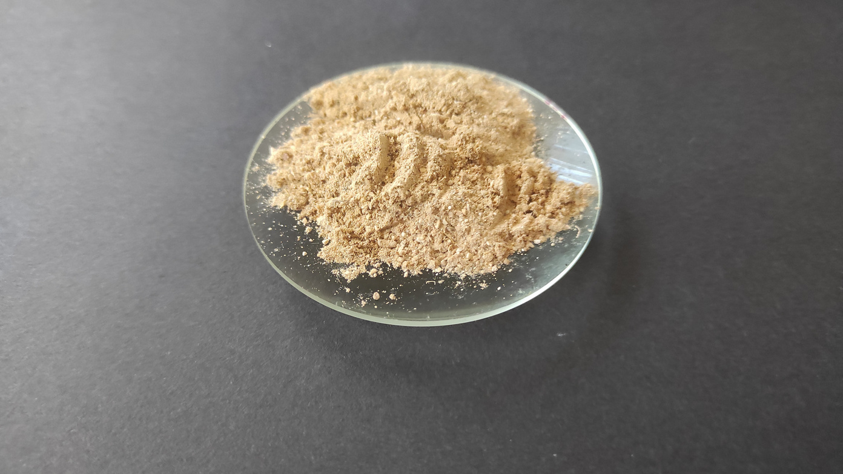
SOLUTION
What Is ExtinGard?
ExtinGard is a next-generation fire extinguishing powder made from recycled eggshell and natural minerals that leaves no chemical residue. It attacks all three corners of the fire triangle at once.
Fully natural content: releases no toxic gas and can be used safely indoors.
Biodegradable: creates no post-fire cleaning or disposal cost.
Broad coverage: observed in testing to be effective on class A, B, C and F fires.
Economical: at a unit cost of 0.0497 TL/g it is 5–6× cheaper than ABC powder.
100% domestic: the raw material supply chain sits entirely within Türkiye.
Patented: TURKPATENT assessed all 11 claims positively.
ExtinGard powder — laboratory production
11
Notes:
Define the product in one sentence, then open the six points in order. Emphasise the patent point — it means novelty verified by an independent authority.

Slide 12
TECHNOLOGY
The Patented Formulation
The composition below is defined verbatim in claim 1 of patent application 2025/021562.
%50
Eggshell (CaCO₃ source)
Recycled bio-waste. Releases CO₂ under heat and dilutes oxygen.
%20
Magnesium hydroxide — Mg(OH)₂
Decomposes endothermically; absorbs heat and releases water vapour.
%10
Calcium hydroxide — Ca(OH)₂
Activates at a higher temperature and sustains the cooling effect.
%10
Aluminium hydroxide — Al(OH)₃
Releases water vapour and slows flame spread.
%8
Kaolin
Forms a heat-resistant mineral blanket layer.
%2
Magnesium stearate
Prevents caking and keeps the powder free-flowing.
The composition was published together with the patent application; there is no issue in sharing it.
ExtinGard · Ateş Kes Team
12
Notes:
The most striking thing about the formulation: half its mass is waste eggshell. The product is both a fire solution and a recycling application.

Slide 13



TECHNOLOGY
Working Principle: The Triple Mechanism
Combustion needs three things: fuel, oxygen and heat. ExtinGard attacks all three at once.
1. Absorbs Heat
2. Dilutes Oxygen
3. Forms a Barrier
Mg(OH)₂ decomposes endothermically at 350 °C and Ca(OH)₂ at 512 °C. These reactions draw heat from the environment, lower the temperature and release water vapour.
The CaCO₃ in the eggshell decomposes at 840 °C and releases CO₂. The released gas lowers the oxygen ratio around the flame and smothers combustion.
Al(OH)₃ and kaolin form a heat-resistant mineral blanket on the burning surface. That layer cuts the fuel off from oxygen.
The three mechanisms working together stop flame spread and reduce the risk of re-ignition.
ExtinGard · Ateş Kes Team
13
Notes:
Drawing the fire triangle on the board works well here. Most competing products use only one or two of these three mechanisms.

Slide 14
TECHNOLOGY
Scientific Basis: The Chemical Reactions
Behind the suppression effect are endothermic decomposition reactions that activate at specific temperatures. An endothermic reaction draws heat from its surroundings — it cools the fire.
Aluminium hydroxide
2 Al(OH)₃ → Al₂O₃ + 3 H₂O
~200 °C
Water vapour is released, the flame is diluted
Magnesium hydroxide
Mg(OH)₂ → MgO + H₂O
350 °C
Heat is absorbed, the environment cools
Calcium hydroxide
Ca(OH)₂ → CaO + H₂O
512 °C
ΔH = +109.5 kJ/mol
Calcium carbonate
CaCO₃ → CaO + CO₂
840 °C
ΔH = +178 kJ/mol; oxygen is diluted
Because the components activate at different temperatures, the suppression effect is spread across every stage of the fire.
ExtinGard · Ateş Kes Team
14
Notes:
This slide shows the jury the scientific depth. The key point: the components activate at staged temperatures, so the suppression effect is not a single moment but continues throughout the fire.

Slide 15
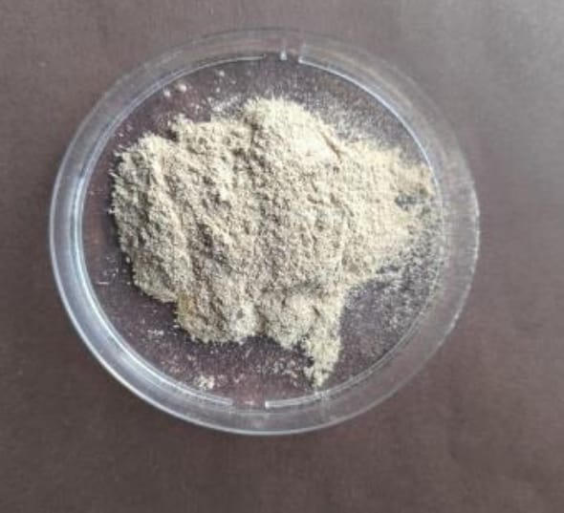
PRODUCTION
The Production Protocol
The production process is standardised as defined in the patent claim; it is reproducible and scalable.
01
Eggshell cleaning
Recycled eggshells are separated from their inner membranes and cleaned.
02
Drying
The cleaned shells are dried with moisture content under control. A critical step for shelf life.
03
Milling
The dried shells are milled together with kaolin into a fine powder.
ExtinGard powder produced to the protocol
04
Mixing and sieving
Mg(OH)₂, Ca(OH)₂, Al(OH)₃ and magnesium stearate are added at the specified ratios; the mixture is sieved until homogeneous.
100% domestic raw material — the supply chain is entirely within Türkiye.
ExtinGard · Ateş Kes Team
15
Notes:
The whole process can be done with simple equipment — an important advantage that eases the move to pilot production.

Slide 16

04
Testing and Validation
How we proved that the product actually works.
ExtinGard · Ateş Kes Team
16
Notes:
Section four: test method, results and field validation. Be sure to restate the transparency note here — certification is not yet complete.

Slide 17


VALIDATION
Our Test Method
We tested the product under controlled conditions on seven different combustible materials representing different fire classes.
Controlled environment
Measured parameters
Tests were run in the laboratory and in controlled open-air conditions, using a fixed quantity of powder.
Extinguishing time, flame spread rate, whether re-ignition occurred and residue on the surface were all recorded.
Reproducibility
Independent observation
Each material was tested more than once; most of the tests were recorded on video.
Field tests were carried out jointly with the Bursa Fire Department Search, Rescue and Response Units.
Transparency note: the tests were performed with our own means and with the support of the fire department. TS EN 615 certification testing has not yet been completed.
ExtinGard · Ateş Kes Team
17
Notes:
Explaining the method clearly builds credibility. Always state the transparency note — the jury will ask anyway, and saying it first earns trust.

Slide 18
VALIDATION
Test Results
Successful suppression was observed on all seven combustible materials.
Combustible Material | Fire Class | Result | Observation
Paper / Cardboard | A | ✓ Successful | Flame spread stopped immediately
Cotton | A | ✓ Successful | Rapid extinction observed
Polyester Fabric | A | ✓ Successful | Effective suppression despite the synthetic structure
Paint Thinner | B | ✓ Successful | Surface filming suppressed the flame in ~5 s
Petrol | B | ✓ Successful | Spread across the liquid surface was prevented; extinguished in 6–8 s
LPG | C | ✓ Successful | Gas flame cut off in 3–4 s
Cooking Oil | F | ✓ Successful | The oil surface was cooled and isolated; complete extinction
7 / 7
A · B · C · F
3 – 8 s
Successful tests
Fire classes covered
Observed extinguishing time
ExtinGard · Ateş Kes Team
18
Notes:
The class F (cooking oil) result is our most valuable finding — the ABC powder on the market is ineffective in this class. It makes a direct difference for kitchen fires.

Slide 19
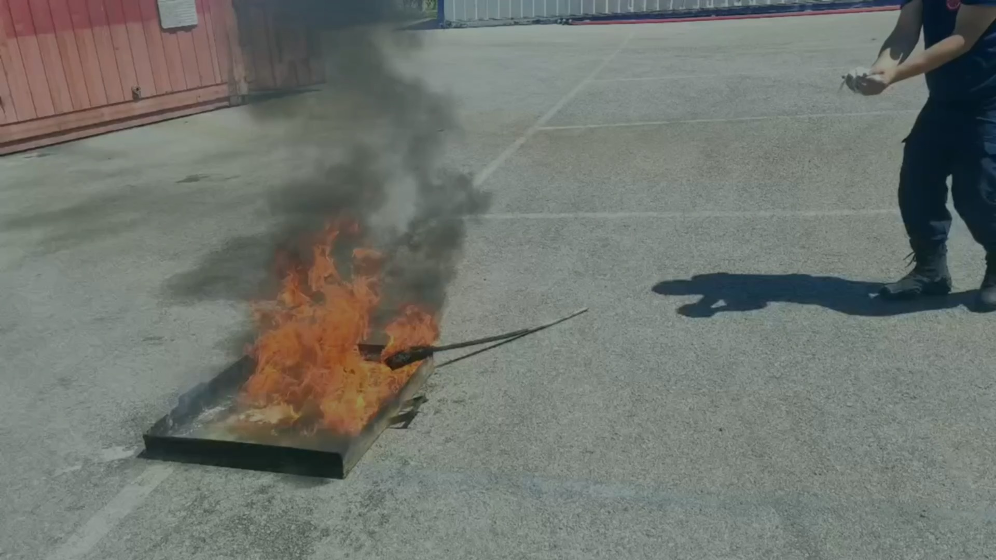
VALIDATION
Field and Institutional Validation
We put the laboratory results to the test in the field, alongside professionals.
Joint field tests were conducted with the Bursa Fire Department Search, Rescue and Response Units.
Letter-of-intent talks have begun for the use of the training ground.
Most of the tests were recorded on video as evidence of reproducibility.
The business model and IP strategy were reviewed at the T3 Entrepreneurship Centre DENEYAP Entrepreneurship Programme.
Field parameters measured: extinguishing time · flame spread rate · CO₂ release · safety impact
ExtinGard · Ateş Kes Team
19
Notes:
Field validation is the step that moves the project from school work to a commercialisable product. The fire department relationship also means a reference customer down the line.

Slide 20

05
Intellectual Property
Our trademark is registered and our patent has been allowed.
ExtinGard · Ateş Kes Team
20
Notes:
Section five: trademark registration and the patent. Emphasise that the patent is not yet final and that the six-month opposition period is running.

Slide 21
INTELLECTUAL PROPERTY
Trademark Registration
The “ExtinGard” trademark has been registered before the Turkish Patent and Trademark Office and a registration certificate has been issued.
Registered Nice Classes
EXTINGARD
01
Fire extinguishing substances
Class of chemicals used in industry and science
Application No
2026/001631
Filing Date
06.01.2026
09
Fire extinguishing apparatus
Fire extinguishing tools and devices, protective equipment
Registration Date
04.06.2026
Protection Period
06.01.2026 – 06.01.2036
35
Marketing and retail
Advertising, marketing and the sale of these goods
A three-class registration protects the product (the powder), the device (the extinguisher) and the sales activity together.
ExtinGard · Ateş Kes Team
21
Notes:
What a three-class registration means: we protect not only the powder but also the device and the sales activity. If we widen the product range later, the trademark protection is already in place.

Slide 22


INTELLECTUAL PROPERTY
Patent
TURKPATENT has completed the examination process for our invention “Fire Extinguishing Powder Composed of Natural Components” and has decided to grant the patent.
EXAMINATION REPORT OUTCOME
Application Details
Novelty
Positive — all 11 claims
Application No
2025/021562
Inventive step
Positive — all 11 claims
Filing Date
24.12.2025
IPC / CPC Class
A62D 1/00
Industrial applicability
Positive — all 11 claims
Number of Claims
11
Process
24.12.2025
14.01.2026
10.02.2026
25.08.2026
Filing
Search report
Examination request
Decision to grant
Once the decision is published in the bulletin, a six-month third-party opposition period runs; if no opposition is filed, the decision becomes final.
ExtinGard · Ateş Kes Team
22
Notes:
The patent is not final yet — there is a six-month opposition period. Say this openly; saying “a decision to grant has been issued” instead of “we have a patent” is both accurate and trust-building.

Slide 23

06
Commercialisation
Competition, cost, market and the road ahead.
ExtinGard · Ateş Kes Team
23
Notes:
Section six: competition, cost, market and roadmap. Give this section more weight for an investor or commercially minded audience.

Slide 24
COMMERCIALISATION
Competitive Comparison
We compared ExtinGard with the two most common dry chemical powders on the market.
Attribute | ExtinGard | BC Powder (NaHCO₃) | ABC Powder (MAP)
Fire class effectiveness | A, B, C and F — the widest coverage | B and C only | A, B, C — ineffective on class F
Unit cost | 0.0497 TL/g | 0.12 – 0.15 TL/g (≈3× more expensive) | 0.25 – 0.30 TL/g (≈5–6× more expensive)
Environmental impact | Biodegradable, leaves no residue | Leaves harmful residue | Residue harmful to soil and water
Human health | Releases no toxic gas | Irritant to the respiratory tract and skin | Irritant to the respiratory tract and skin
Domestic content | 100% domestic raw material | Import-dependent | Import-dependent
ExtinGard is the only option that leads simultaneously on coverage · cost · environmental impact.
ExtinGard · Ateş Kes Team
24
Notes:
Competitors can be good on one axis; we are good on all three. Emphasise the class F difference in particular.

Slide 25


COMMERCIALISATION
Cost Analysis
Unit cost removes the single biggest barrier to widespread adoption.
≈ 225,000 TL
Annual saving against ABC powder at 1 tonne/year usage (82%)
5 – 6×
Unit cost advantage over ABC powder; 3× over BC powder
%100
Domestic, bio-waste-derived raw material — no currency risk
ExtinGard · Ateş Kes Team
25
Notes:
The cost advantage means accessibility: large-scale stockpiling becomes economical for public institutions.

Slide 26




COMMERCIALISATION
Market Analysis
PFAS restrictions and the climate-driven rise in fires create favourable timing for eco-friendly extinguishants.
TAM
SAM
SOM
$5.02 B
$60.3 M
$0.30 M
Global PFAS-free fire extinguishant segment
Addressable market in Türkiye
Year-1 target market share
$33.5 B
%18
%30
2023+
Global fire extinguishing market (2024)
Annual growth of the PFAS-free segment
Increase in global fire frequency
EU PFAS restriction directives in force
ExtinGard · Ateş Kes Team
26
Notes:
Market timing is in our favour: the EU's PFAS restrictions are forcing incumbents to reformulate, while we were PFAS-free from the start.

Slide 27



COMMERCIALISATION
Business Model and Target Audience
We plan a three-channel, staged go-to-market. Each stage builds the credibility base for the next.
PRIORITY 1
PRIORITY 2
LONG TERM
B2G — Public Procurement
B2B — Corporate Sales
B2C — Consumer Kit
The General Directorate of Forestry, AFAD and municipalities. High-volume, recurring procurement.
Industrial plants, logistics hubs and power stations. Refill agreements.
Home and vehicle mini extinguisher kits. A brand-awareness channel.
Target Institutions
User Profiles
Public institutions — fire departments, municipalities, AFAD, OGM
Facility managers — those who make the investment decision
Industrial plants — manufacturing, chemical and food factories
Procurement officers — sourcing units
Logistics hubs — warehouses, bonded stores, distribution
Occupational safety specialists and EHS personnel
Power stations and battery stores
Fire crews and fire safety consultants
ExtinGard · Ateş Kes Team
27
Notes:
B2G is our priority because a public reference brings both volume and credibility. The buyer and the user are different people — we frame the message for each.

Slide 28
COMMERCIALISATION
Roadmap
Over the next 12 months we will move forward with a focus on certification and pilot production.
Q1
Q2
Q3
Q4
Jun – Sep 2026
Sep – Dec 2026
Jan – Mar 2027
Mar – Jun 2027
Field tests
Certification
Pilot production
Investment and export
Controlled tests at the Bursa Fire Department training ground
Application process for the TS EN 615 standard
Setting up the pilot production line
Investment round and export strategy
OUTPUT
OUTPUT
OUTPUT
OUTPUT
Quantitative suppression data and a technical report
Standard compliance certificate
First B2B sales contracts
Seed capital + SME grant application
Long term: PCT international patent expansion — priority markets are the EU (EPO) and the Gulf states.
ExtinGard · Ateş Kes Team
28
Notes:
Q2 is the most critical quarter: without the TS EN 615 certificate we cannot enter public tenders.

Slide 29


CREDENTIALS
Achievements and Institutional Relationships
T3 Entrepreneurship Centre – DENEYAP Entrepreneurship Programme
Participation in the training camp; business model and IP strategy review received.
Bursa Fire Department Search, Rescue and Response Units
2nd place
Joint field tests and professional technical assessment meetings.
Üsküdar University
10th Science and Ideas Festival
BTSO Kamil Tolon Science and Art Centre
The R&D environment and laboratory infrastructure where the product was developed.
Second prize in the health category — independent jury confirmation of the project's scientific validity.
Turkish Patent and Trademark Office
Registered trademark (2026/001631) and allowed patent application (2025/021562).
ExtinGard · Ateş Kes Team
29
Notes:
Three different kinds of validation: academic (Üsküdar), entrepreneurial (T3) and operational (Bursa Fire Department) — with formal IP protection on top.

Slide 30
CONCLUSION
In Summary
ExtinGard has grown from a school project into a registered and patented product.
Scientific basis
Demonstrated performance
The triple suppression mechanism rests on endothermic reactions that activate at staged temperatures.
Successful suppression on seven different combustible materials; effective in classes A, B, C and F.
Protected intellectual property
A ready market
A TURKPATENT registered trademark and a patent application with all 11 claims allowed.
PFAS restrictions and the cost advantage leave a clear opening in the B2G and B2B channels.
Next step: TS EN 615 certification and a pilot production line.
ExtinGard · Ateş Kes Team
30
Notes:
Closing summary. Repeat the four points one by one, then finish with the next step.

Slide 31
APPENDIX
References
01
Anderson, H., Roberts, L., & Kim, S. (2023). Plant-Based Fire Retardants: A New Approach to Sustainable Fire Safety. Green Chemistry, 12(4), 312–328.
02
EPA (2019). Ozone-Depleting Substances and Fire Suppressants. Environmental Protection Agency.
03
IPCC (2023). Climate Change 2023: Synthesis Report. Intergovernmental Panel on Climate Change.
04
Kırtaş, H. A., & Altundağ, H. (2023). Production, Refilling and Maintenance of Portable Fire Extinguishers. International Journal of Fuels, Combustion and Fire, 11(1), 91–103. [in Turkish]
05
Lee, K., Smith, J., & Walker, P. (2021). Health Impacts of Fire Suppressant Chemicals: A Review. Environmental Research, 56(3), 223–240.
06
Miller, R., & Carter, D. (2022). Calcium Carbonate in Fire Suppression Applications. Journal of Chemical Studies, 38(1), 55–67.
07
General Directorate of Forestry (2023). Forest Fire Statistics and Response Strategies in Türkiye. Republic of Türkiye Ministry of Agriculture and Forestry. [in Turkish]
08
Turkish Patent and Trademark Office (2026). Trademark Registration Certificate, Registration No 2026/001631.
09
Turkish Patent and Trademark Office (2026). Examination Report and Decision to Grant, Application No 2025/021562.
10
UNEP (2022). Spreading Like Wildfire: The Rising Threat of Extraordinary Landscape Fires. United Nations Environment Programme.
ExtinGard · Ateş Kes Team
31
Notes:
The references slide. It is not read out during the talk; it is there as a reference for the jury and for readers.

Slide 32




Thank You
Thank you for listening. We would be glad to answer your questions.
E-mail
Phone
extingard@gmail.com
0542 245 24 46
Instagram
LinkedIn
@extingard
ExtinGard
ExtinGard · TURKPATENT registered trademark (2026/001631) and allowed patent application (2025/021562)
Notes:
Closing. Move into the Q&A section from here.

